Slide 1
Isoquant

Slide 2
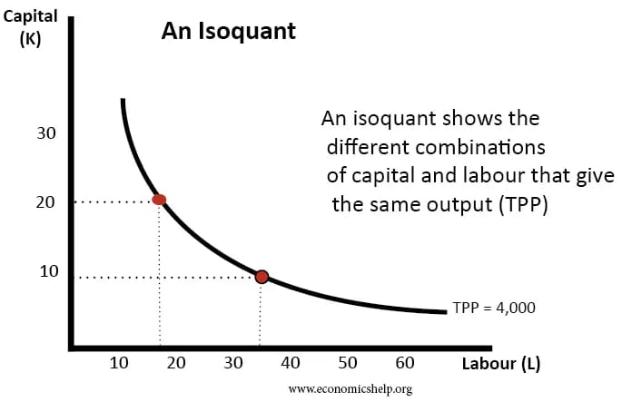
Isoquant
An isoquant shows all combination of factors that produce a certain output.

Slide 3
In this diagram, the isoquant shows all the combinations of labour and capital that can produce a total output (Total Physical Product TPP) of 4,000. In the above isoquant, this could be20 capital and 18 labour or (more capital intensive)9 capital and 35 labour. (more labour intensive.
An isoquant is usually shaped convex to the origin because of the law of Marginal Rate of Technical Substitution (MRTS) which means there are diminishing returns from using more of one factor of production.

Slide 4
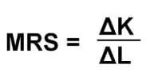
Marginal rate of factor substitution

Slide 5
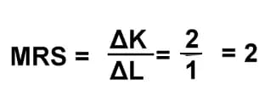
Marginal rate of factor substitution
The marginal rate of substitution is the amount of one factor (e.g. K) that can be replaced by one factor (e.g. L). If 2 units of capital could be replaced with one-factor labour, the MRS would be 2

Slide 6
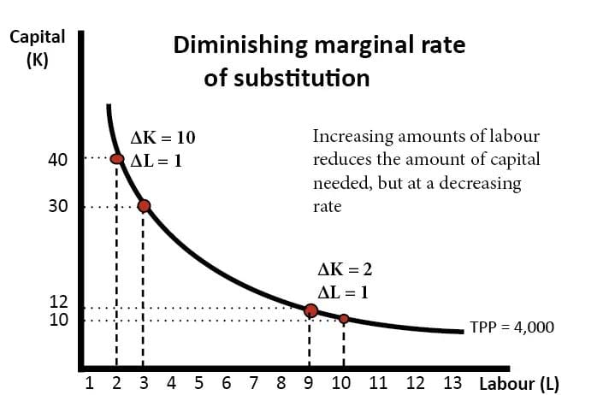
Diminishing marginal rate of substitution

Slide 7
If the firm employs 2 L and 40 K. Then employing one extra worker can enable it to save 10K. This is quite an efficient saving. The firm only has to pay one extra worker but can save the cost of 40.
However, at a combination of 9 Labour, employing an extra worker enables a saving of only 2 capital. Therefore, the more that workers are employed, there is diminishing rate at which you can substitute the other factor. There comes a point, where employing more workers barely saves any capital at all. This is when diminishing returns of labour is very high – workers effectively get in each other’s way.
As one moves down the isoquant, output remains the same. Therefore the output gained from employing more labour must equal the output lost from employing more capital.
MPP (L) x ΔL = MPP (K) x ΔK

Slide 8
This equation gives us

