Slide 1
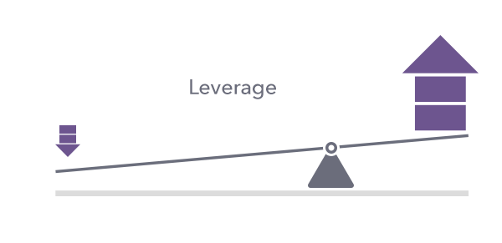
LEVERAGE

Slide 2
Leverage
Leverage means the employment of assets or funds for which the firm pays a fixed cost or fixed return.
The concept that is used to study the effects of various mix of debt and equity on the shareholder's return and risk in the capital structure of a firm is called leverage.

Slide 3
What is leverage?
Leverage refers to borrowing funds for a particular purpose with an obligation to repay these funds, with interest, at an agreed-to schedule. The idea behind leverage is to help borrowers achieve a higher return with a smaller investment.

Slide 4
How does leverage work?
If and when your business is ready to increase its scale of operations, expand into new markets, or update existing infrastructure, you’re going to need funds.
However, if you don’t have enough equity or cash upfront, you’ll have to borrow funds.
Two ways to borrow capital are to issue bonds (equity financing) or borrow directly from lenders (debt financing).Equity financing involves selling your equity in exchange for funding. One of the biggest benefits of equity financing is that it doesn’t lead to the company having to make interest payments or any principal repayment. Some of the most common examples of equity financing are initial public offerings (IPOs) and crowdfunding.
Debt financing involves a company borrowing money to fund working capital requirements. When a company borrows money, it needs to make interest payments as well as repay the principal. Taking a loan is a common debt financing example.

Slide 5
Types of Leverage
Operating Leverage
Financial Leverage
Combined Leverage

