Slide 1
Socialistic Economy (Socialism)
The Father of Socialism is Karl Marx. Socialism refers to a system of total planning, public ownership and state control on economic activities. Socialism is defined as a way of organizing a society in which major industries are owned and controlled by the government, A Socialistic economy is also known as ‘Planned Economy’ or ‘Command Economy’.

Slide 2
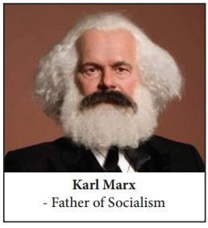
In a socialistic economy, all the resources are owned and operated by the government. Public welfare is the main motive behind all economic activities. It aims at equality in the distribution of income and wealth and equal opportunity for all. Russia, China, Vietnam, Poland and Cuba are the examples of socialist economies. But, now there are no absolutely socialist economies.

Slide 3


Slide 4
Features of Socialism:
Public Ownership of Means of Production: All resources are owned by the government. It means that all the factors of production are nationalized and managed by the public authority.
Central Planning: Planning is an integral part of a socialistic economy. In this system, all decisions are undertaken by the central planning authority.
Maximum Social Benefit: Social welfare is the guiding principle behind all economic activities. Investments are planned in such a way that the benefits are distributed to the society at large.
Non-existence of Competition: Under the socialist economic system there is absence of competition in the market. The state has full control over production and distribution of goods and services. The consumers will have a limited choice.

Slide 5
Absence of Price Mechanism: The pricing system works under the control and regulation of the central planning authority.
Equality of Income: Another essential feature of socialism is the removal and reduction of economic inequalities. Under socialism private property and the law of inheritance do not exist.
Equality of Opportunity: Socialism provides equal opportunity for all through free health, education and professional training.
Classless Society: Under socialism, there is a classless society and so no class conflicts. In a true socialist society, everyone is equal as far as economic status is concerned.

