Slide 1
Unit1-Introduction to Computer Fundamentals: Definition of Relational Database, Mode of data transfer
Sweta Sushmita Tigga
Lecture- B.Sc Microbiology, Sem-V
Department of Microbiology,
DSPMU, Ranchi

Slide 2
Unit1-Introduction to Computer Fundamentals: Definition of Relational Database, Mode of data transfer
Database
Relational Database
Relational Database Management System (RDBMS)
Programming Language

Slide 3
Database
Database is an organized collection of
Structured information
Or data-
Typically stored in electronically in a computer system
Database Mangement System (DBMS)
Controlled

Slide 4
Relational Database
Relational Database is a type of database, that stores and provide access to data points that are related to one another.
Relational databases are based on the relational model, an intuitive, straightforward way of representing data in tables.
In a relational database, each row in the table is a record with a unique ID called the key. The columns of the table hold attributes of the data, and each record usually has a value for each attribute, making it easy to establish the relationships among data points

Slide 5
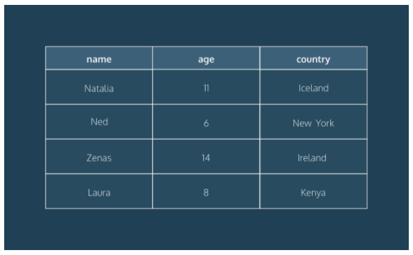
Relational Database

Slide 6
Relational Database
Relational Databases are structured- the data table, views, indexes. This separation means that database administrators can manage physical data storage without affecting access to that data as a logical structure. For example, renaming a database file does not rename the tables stored within it.

Slide 7
Relational Database Mangement System (RDBMS)
A relational database management system (RDBMS) is a program that allows you to.
Create
update
and administer a relational database.
Most relational database management systems use the SQL language to access the database

Slide 8
SQL (Structured Query Language)
SQL (Structured Query Language) is a programming language used to communicate with data stored in a relational database management system. SQL syntax is similar to the English language, which makes it relatively easy to write, read, and interpret.
Many RDBMS use SQL (and variations of SQL) to access the data in tables. For example, SQLite is a relational database management system. SQLite contains a minimal set of SQL commands (which are the same across all RDBMSs). Other RDBMS may use other variants.

Slide 9
Popular Relational Database Management System
MySQL
PostgreSQL
SQLite

Slide 10
SQLite
SQLite is a popular open source SQL database. It can store an entire database in a single file. One of the most significant advantages this provides is that all of the data can be stored locally without having to connect your database to a server.
SQLite is a popular choice for databases in cellphones, PDAs, MP3 players, set-top boxes, and other electronic gadgets.

Slide 11
MySQL
MySQL is the most popular open source SQL database. It is typically used for web application development, and often accessed using PHP.
The main advantages of MySQL are that it is easy to use, inexpensive, reliable (has been around since 1995), and has a large community of developers who can help answer questions.
Some of the disadvantages are that it has been known to suffer from poor performance when scaling, open source development has lagged since Oracle has taken control of MySQL, and it does not include some advanced features that developers may be used to.

Slide 12
PostgreSQL
PostgreSQL is an open source SQL database that is not controlled by any corporation. It is typically used for web application development.
PostgreSQL shares many of the same advantages of MySQL. It is easy to use, inexpensive, reliable and has a large community of developers. It also provides some additional features such as foreign key support without requiring complex configuration.
The main disadvantage of PostgreSQL is that it is slower in performance than other databases such as MySQL. It is also less popular than MySQL which makes it harder to come by hosts or service providers that offer managed PostgreSQL instances.

Slide 13
Thank You

